Slide 1
Project Benson
Group 6
Danny, Kevin, John, Navina

Slide 2
Outline
Introduction
Datasets
Results
Plan for Action
Approach for next year
Notes:
Danny - I will talk about the project motivation and how we approached the problem
Kevin - Data Aggregation and a high level view of out data pipeline
John - Will show the resulting visualizations of the data
Navina - Will share our solution for the customer and what we would do differently for next year’s gala

Slide 3
Goal
Maximize the number of signatures and contributions
Data-backed recommendation
Chose metrics to compare each station

Slide 4
Metrics
Number of riders
More people, more signatures
Income of the area
More wealthy people, more money to give
Charitability in the area
Historical donations → future donations
Notes:
The first we decided on is the number of riders. If more people pass by the WTWY employees, they are more likely to get signatures.
Second, the income per capita of an area. If a given area has more wealthy people, and they choose to attend the event then they are more likely to have the means to contribute.
-If an area has historically been more charitable, if they attend, they will be more likely to donate to the cause

Slide 5
Datasets
Notes:
We utilized five sets data to conduct our analysis.

Slide 6
Data Aggregation
Turnstile and station location data from MTA
Official MTA Website ^{(1,2)}
Reverse Geocoding
Google API ⁽³⁾
Charity Contributions data: www.city-data.com
Data from government and private sources ⁽⁴⁾
Income Per Capita data: www.incomebyzipcode.com
Data from current income statistics from the US Census Bureau ⁽⁵⁾
Notes:
We wrote scripts to scrape and interact with websites to programmatically obtain information:
These include
the MTA website, to get ridership data and station location,
Google’s Reverse Geocode API, used to identify the zip code of each station,
city-data.com, to obtain the history of charitable giving by zip code, as well as
income data from incomebyzipcode.com, to identify the zip codes with the most means to donate.

Slide 7
Pipeline
Charitable Contributions Rank
Cleaned Datasets
Action
Plan
Ridership Rank
Available Resources
Income Rank
Notes:
Once obtaining the raw data, our steps forward were
to clean and manipulate it into a useable form,
then to assess station ridership, as well as charity and income by zipcode.
Combining these findings, we arrived at a plan of action for a given number of volunteers.

Slide 8
Results

Slide 9
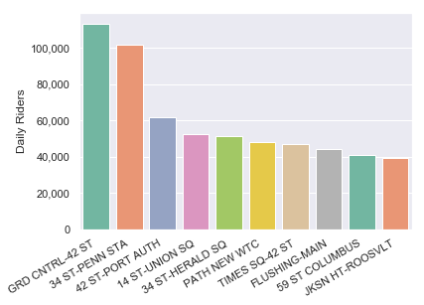
Ridership Rankings

Slide 10
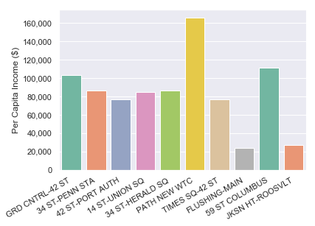
Income Rankings

Slide 11
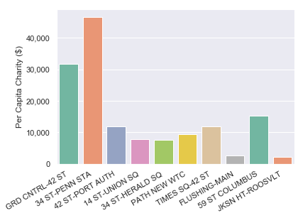
Charity Contribution Data

Slide 12
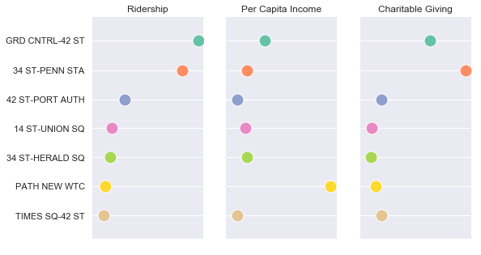
Summary Of Data

Slide 13
Plan for Action

Slide 14
Top Picks
Grand Central Station
42nd St Port Authority Station
34th St Penn Station
WTC Station
Percent volunteer allocation per station: 40-30-20-10

Slide 15
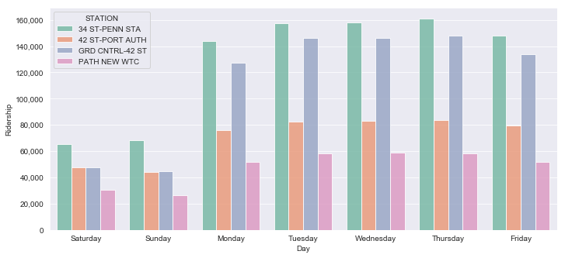
Daily Ridership
Weekday: Penn Station, Grand Central Weekend: Penn Station

Slide 16
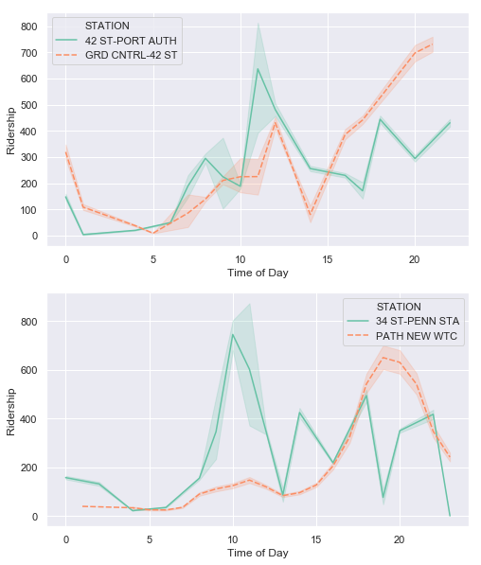
Ridership by Time of Day
42nd St Grand Central
4:00 pm - 8:00 pm
42nd St Port Auth
10:00 am - 2:00 pm
34th St Penn Station
8:00 am - 1:00 pm
WTC Station
7:00 pm - 9:00 pm
(in thousands)

Slide 17
Approach for Next Year

Slide 18
Future Direction
Look at additional features
Gender, Technology and Education
Optimal team size at each location
Incorporate survey data to determine times of day with higher chances of interaction

Slide 19
Questions?

Slide 20
Resources
Data Sources
http://web.mta.info/developers/turnstile.html
http://web.mta.info/developers/data/nyct/subway/StationEntrances.csv
https://developers.google.com/maps/documentation/geocoding
http://www.city-data.com/
https://www.incomebyzipcode.com/help/faq#datasources
Github Repository
https://github.com/ngovindaraj/MTA_Turnstile

